Slide 1
Differential Privacy : An Introduction
Sean Roche

Slide 2
Using Data and Protecting Privacy
Differential Privacy’s purpose
Protecting privacy while utilizing useful data

Slide 3
Data Anonymization, or the lack thereof
“De-identifying” data and why it does not work
Netflix Prize

Slide 4
Data Anonymization, or the lack thereof (cont.)
Anonymized Data
Cross-Reference Data

Slide 5
Data Anonymization, or the lack thereof (cont.)
5 digit ZIP, gender, date of birth: 87%
Place, gender, date of birth: 53%

Slide 6
Re-Identification of William Weld
Governor of Massachusetts William Weld identified from a dataset of “de-identified” data

Slide 7
History of Differential Privacy (Pre-2006)
Fundamental Law of Information Recovery

Slide 8
History of Differential Privacy (2006 – Present)
2006 research completed by Cynthia Dwork and others
From top: Cynthia Dwork, Kobbi Nissim, Frank McSherry, and Adam D. Smith

Slide 9
Differential Privacy: A Simple Introduction
Flip a Coin
If heads
If tails, flip again
Keep original result
If heads, keep original result
If tails, switch result

Slide 10
ε-Differential Privacy
Pr[A(x) ∈ S] < e^{ε} Pr[A(y) ∈ S]
x and y are datasets that differ by one element
A is an algorithm that introduces randomness, common example being the coin toss
S is a subset of events in A
Important concept: e^{ε} is essentially the ratio at which the two probabilities differ

Slide 11
Common Mechanisms of Differential Privacy
Laplace Mechanism
Geometric Mechanism
Exponential Mechanism
Staircase Mechanism
[insert textbook source]

Slide 12
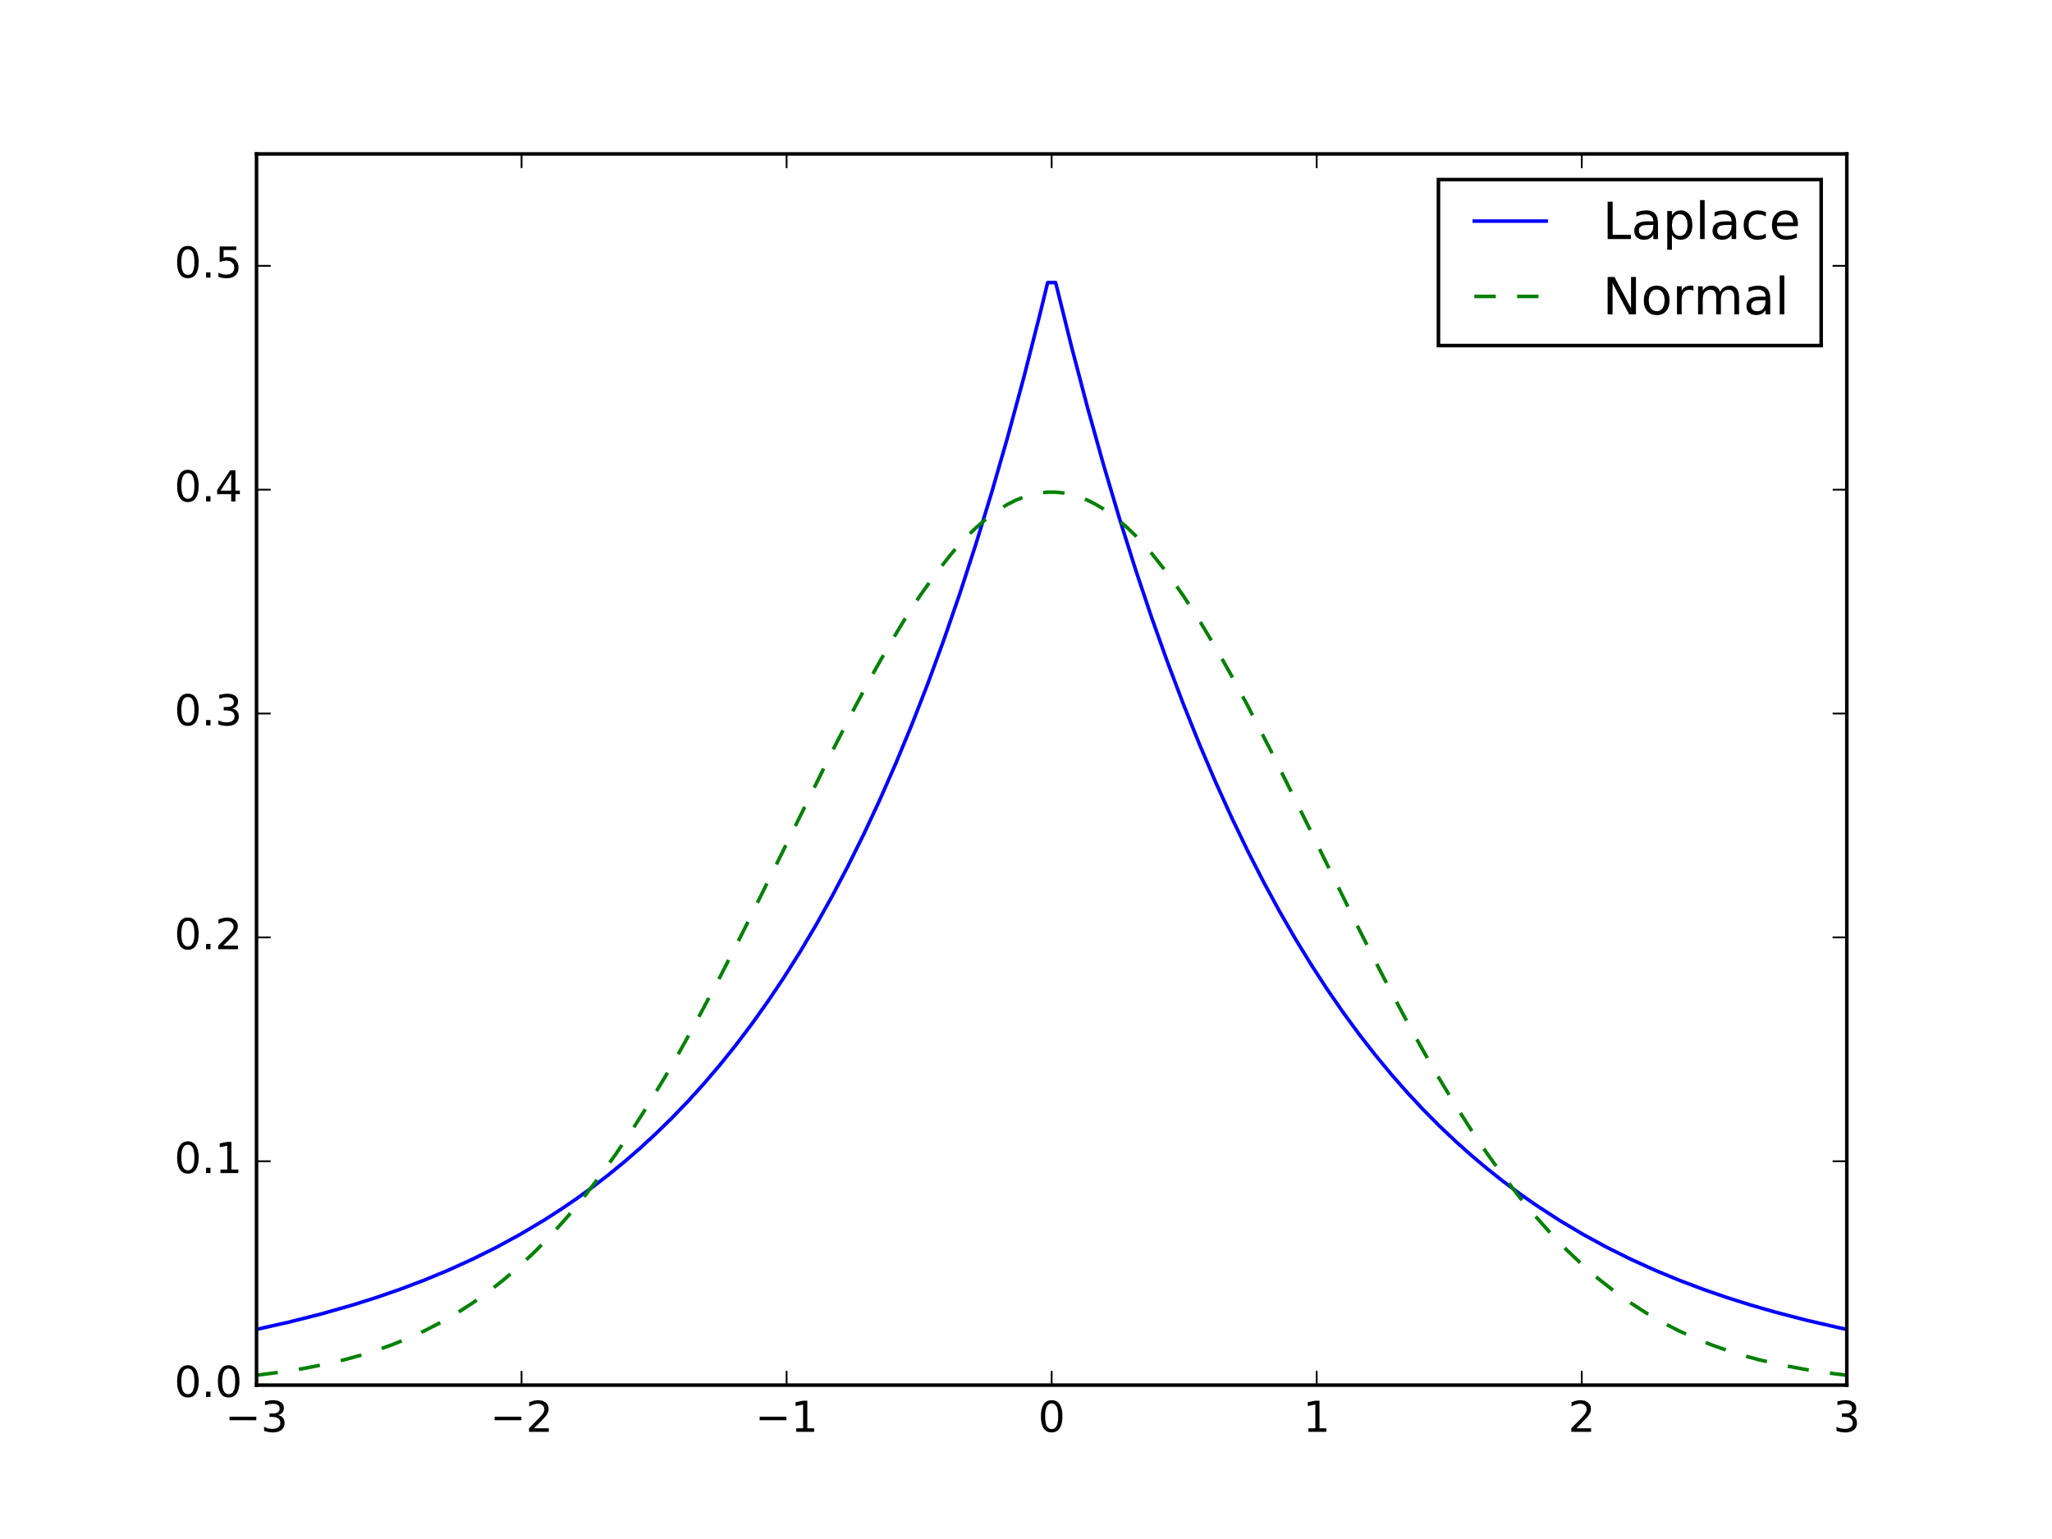
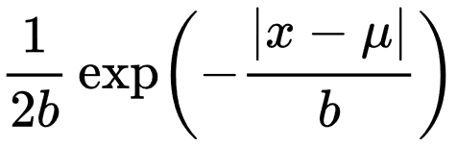
Laplace Mechanism
Most common mechanism to achieve differential privacy
Laplace Distribution
Probability density function
Double exponential distribution

Slide 13
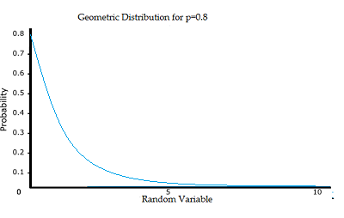
Geometric Mechanism
Adds noise as integers
Usually used in datasets with integer answers
X can be drawn from geometric distribution
[insert α designation, x element of integers]
Pr[X = x] = ((1 + α) / (1 – α))(α^{|x|})

Slide 14
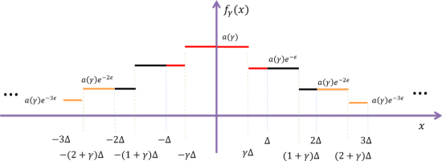
Staircase Mechanism
For single real-valued query functions
Purpose is to minimize worst case cost amongst all possible outputs
Performs better than the Laplace mechanism for single real-valued query functions
[source for graph]

Slide 15
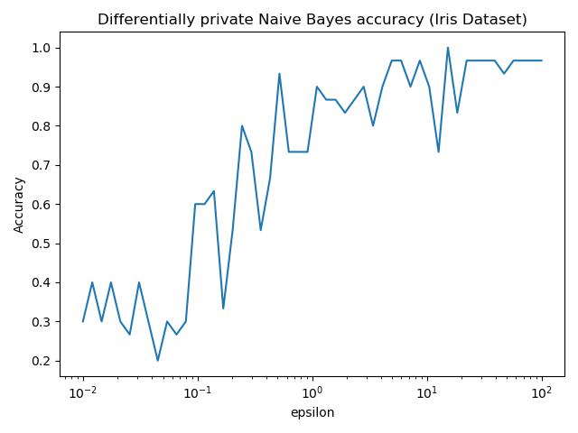
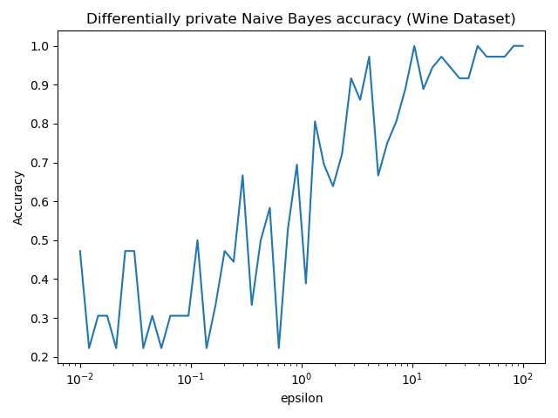
Using IBM’s Differential Privacy Library

